Slide 1
Storage SOP
How to add storage from Flask IBM to vm

Slide 2
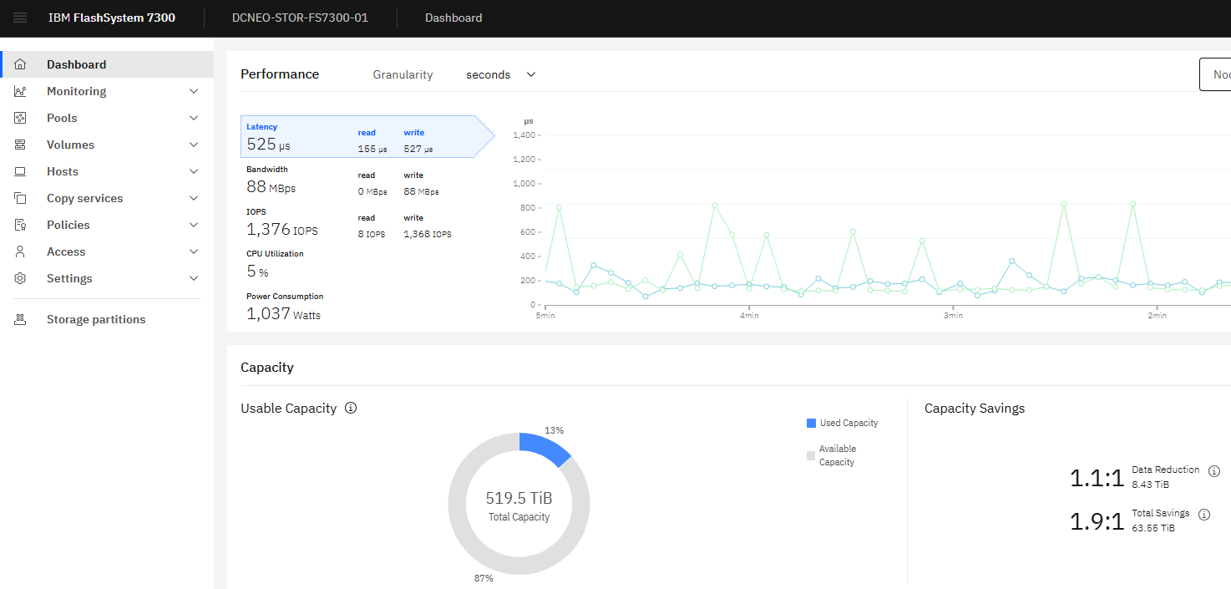
Loggin to the storage IBM
IP: 10.2.6.8
User: Superuser
Password: P@ssw0rd

Slide 3
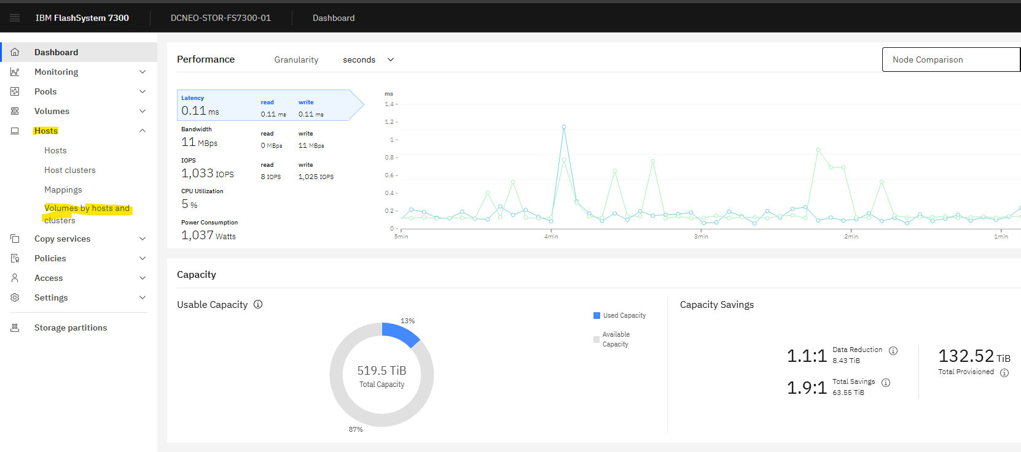
Host
Volume by host and cluster

Slide 4
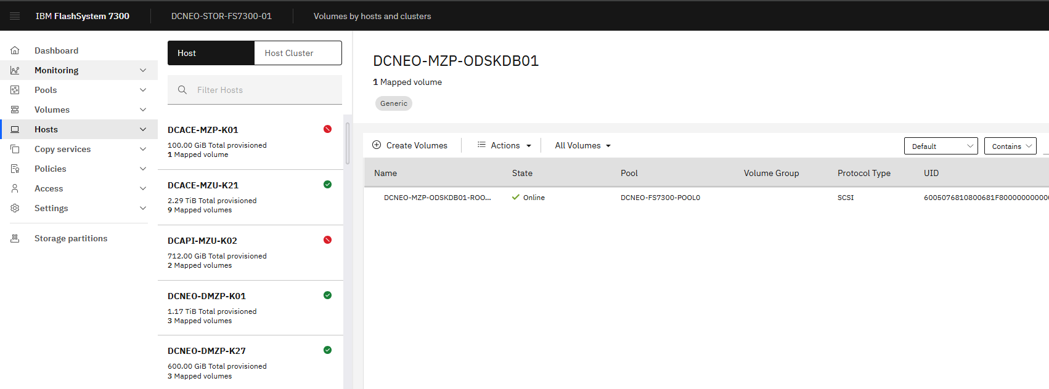
Filter
Search by using hostname of the LPAR/KVM

Slide 5
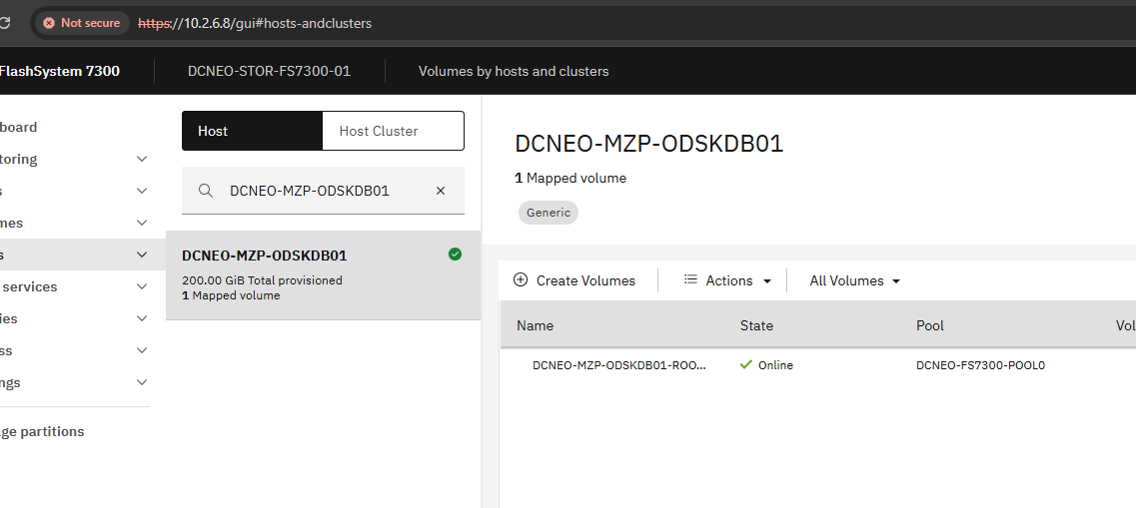
DCNEO-MZP-ODSKDB01
Click on Create volume

Slide 6
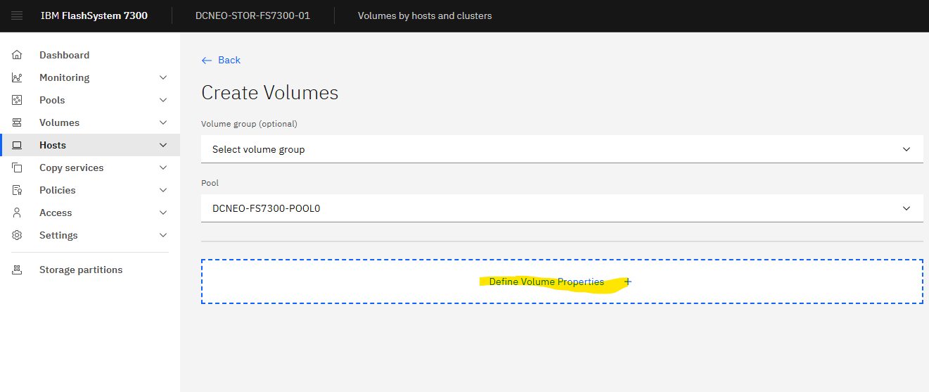
Create Volumes
Define Volume Properties

Slide 7
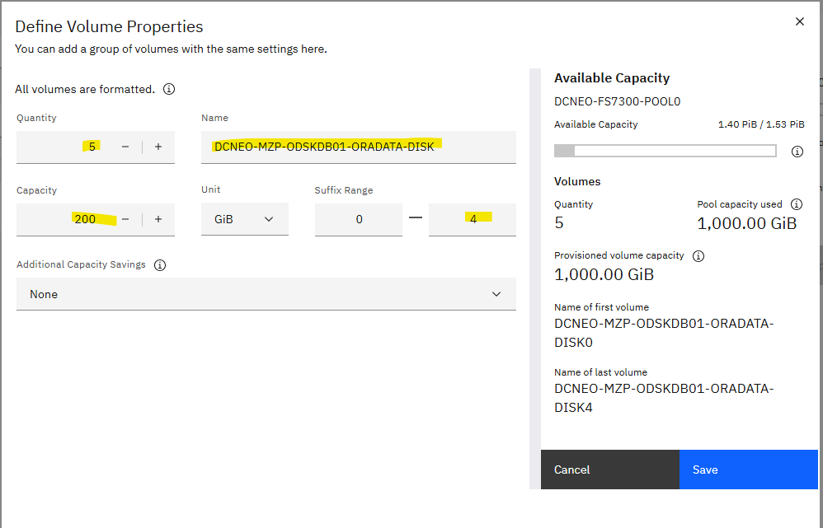
Define Volume Properties
Add desired disks
Click on save

Slide 8
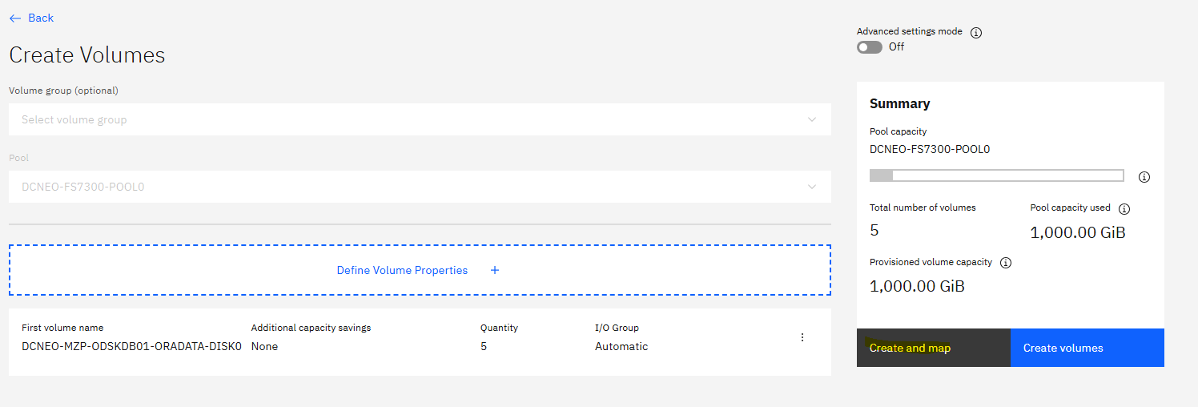
Click on create and map

Slide 9
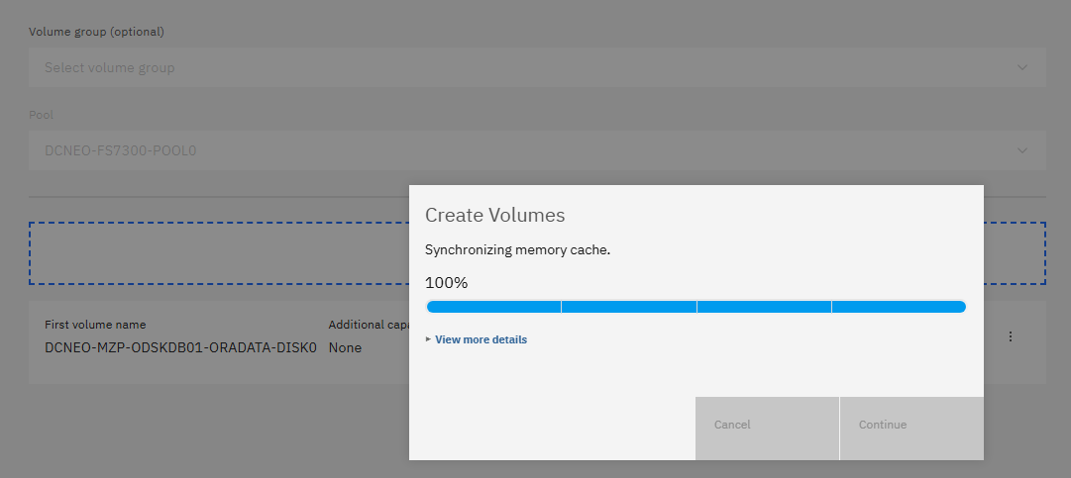
Click on continue

Slide 10
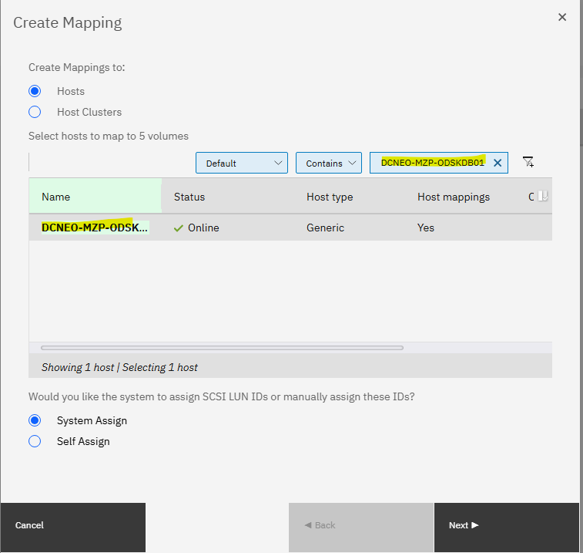
Create and map
Search LPAR/KVM
And next

Slide 11
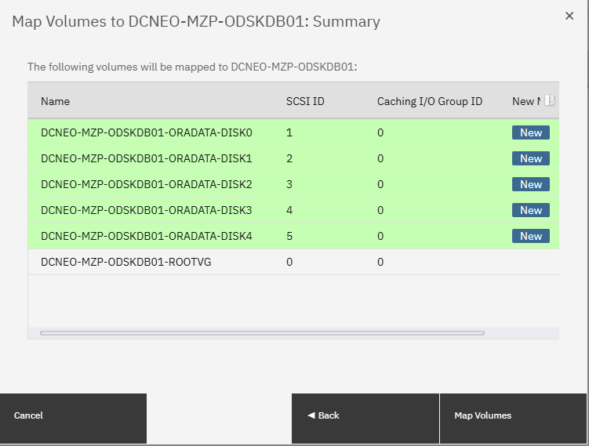
Click on Maps volumes

Slide 12
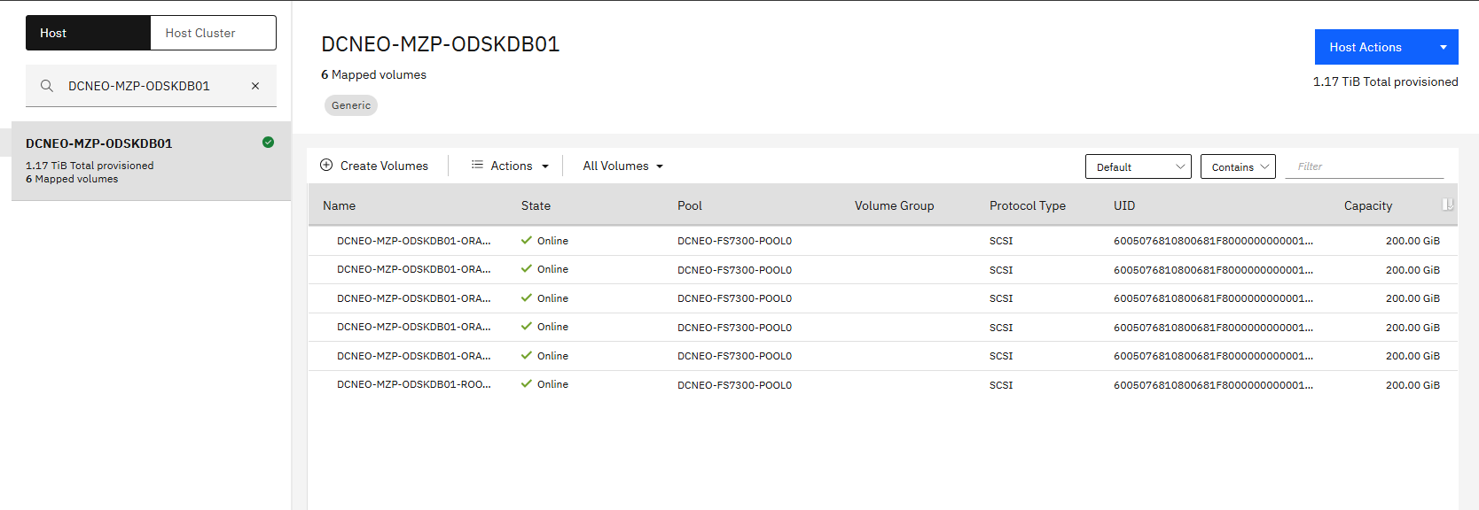
You can see the new disks mapped.
Go to LPAR/KVM and rescan it.

Slide 13
Create Mount Point On LPAR/KVM
rescan-scsi-bus.sh -a
vi /etc/multipath.conf
}
multipath {
wwid 36005076810800681f8000000000001a1
alias DCNEO-MZP-ODSKDB01-ORADATA-DISK0
}
2) Mulitpath –ll
3) pvcreate /dev/mapper/DCNEO-MZP-ODSKDB01-ORADATA-DISK0
5) vgcreate ORADATAVG /dev/mapper/DCNEO-MZP-ODSKDB01-ORADATA-DISK0

Slide 14
Steps:
6) lvcreate -l 100%FREE -n ORADATALV ORADATAVG
7) mkfs.xfs /dev/ORADATAVG/ORADATALV
8) Mkdir /oradata
9) vi /etc/fstab
/dev/ORADATAVG/ORADATALV /oradata xfs defaults 0 0
10) mount –a
11) systemctl daemon-reload
12) df -hT

